Slide 1
Managing contingent recruitment with TalentLink
Prepared for: West Midlands Employers

Slide 2
Contents
Typical benefits achieved with TalentLink™ Contingent
Managing detailed processes
Managing rate complexity
Managing terms and conditions
Managing Rates : Markups and Margins
Pushing conditions to back office / payroll systems
Timesheeting

Slide 3
Contents cont.
Recruitment Supplier Portal
Online worker experience
Line Managers experience
Producing contingent documentation
Managing AWD notification
Managing the extensions process
Reporting on contingent recruitment

Slide 4
What is contingent recruitment for Lumesse?
Wikipedia defines contingent labour as
“A provisional group of workers who work for an organisation on a non-permanent basis”
Within TalentLink™ there are two core workstreams:
Salaried/Permanent
Where the Hires are paid directly by the customer
Contingent/Contract
Where the Hires are most likely sourced from an external company, like a recruitment consultancy or agency.
Agency temporary worker on fixed rate, typically paid hourly
Consultant providing short term advice to a company.
Contractor with their own company but providing skills and knowledge to another company.
http://en.wikipedia.org/wiki/Contingent_Workforce

Slide 5
Typical benefits achieved with TalentLink™ Contingent
The following are just some of the reasons customers deploy TalentLink for Contingent recruitment:
By rationalising their relationship with all suppliers and controlling their costs, companies and their stakeholders are able to gain visibility on the overall margins they are paying on labour suppliers, thus allowing significant reductions in some areas;
Through the rationalisation of the supply chain, controlling the rogue expenditures and having access to credible benchmark data, line managers are able to reduce the average pay rates for different roles, thus further reducing their overall expenditure;
TalentLink™ provides an alert system, informing stakeholders of contract finishing dates. This prevented last minute extensions and put the line manager in a position to negotiate firmly with suppliers;
The introduction of online time-sheeting can deliver significant cost savings and administrative efficiencies.
This process leads to better knowledge of the whole workforce and all related data. HR stakeholders now have access to the sort of inputs that help them considerably with their resource planning.

Slide 6
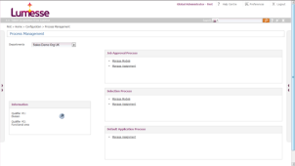
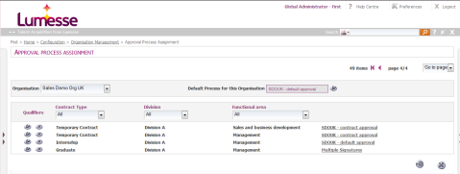
Managing detailed processes
TalentLink provides comprehensive process mapping support to ensure that all compliance and selection steps are tracked.
Included in this area:
An unlimited number of processes can be created into the system
Process can be mapped with pre-qualifier fields in detail to key indicators, departments, locations for automatic process assignment to the correct context.
Financial approval processes can be automatically controlled
Interfaces from procurement or financial EPR systems can also pass financial approval to TalentLink before recruitment can start.

Slide 7
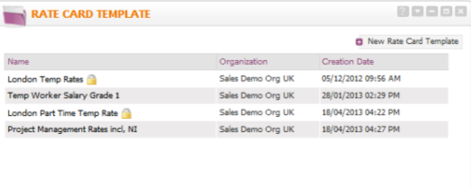
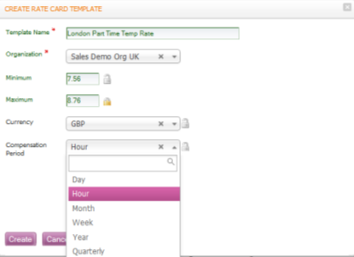
Managing rate complexity
We understand that in the contingent world there are a greater variety of rates and terms offered to workers, we created “Rate Card Templating” to help customers manage complex contingent terms without impacting line manager experience.

Slide 8
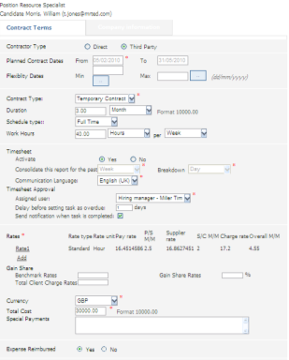
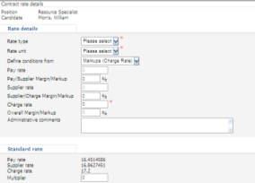
Managing terms and conditions
In the contingent labour market the terms and conditions offered to the workers can vary enormously.
TalentLink™ Contingent Condition Form captures all the essential information required to pay the worker, including:
Worker/Supplier bank details
Standard rates and rate variables e.g. overtime, weekend
Contract terms and conditions
Key Dates
All terms and conditions can be passed for financial approval before being submitted to payroll

Slide 9
Managing Rates : Markups and Margins
There are a number of ways of calculating Rates within TalentLink Contingent, the essential definitions are these:
A markup is the difference between a higher figure and a lower figure, as a percentage of the lower figure. For example, if a pay rate is €10 and a supplier rate is €11, the pay/supplier markup is the difference (€1) as a percentage of the pay rate (€10) or 10%.
Selecting the option Markups allows you to enter the Charge Rate, the Supplier/Charge Markup and the Pay/Supplier Markup, and the Supplier Rate and Pay Rate will be calculated automatically.
Selecting the option Rates Markups allows you to enter the Charge Rate, the Supplier Rate and the Pay Rate, and the Supplier/Charge Markup and the Pay/Supplier Markup will be calculated automatically.
A margin is the difference between a higher figure and a lower figure, as a percentage of the higher figure. For example, if a pay rate is €10 and a supplier rate is €11, the pay/supplier margin is the difference (€1) as a percentage of the supplier rate (€11) or 9.09%.
Selecting the option Margins allows you to enter the Charge Rate, the Supplier/Charge Margins and the Pay/Supplier Margins, and the Supplier Rate and Pay Rate will be calculated automatically
Selecting the option Rates Margins allows you to enter the Charge Rate, the Supplier Rate and the Pay Rate, and the Supplier/Charge Margins and the Pay/Supplier Margins will be calculated automatically.

Slide 10
Pushing conditions to back office / payroll systems
Once conditions and timesheets have completed their workflows within TalentLink™ all data can be exported to existing financial systems for pay and billing.
Lumesse have deployed a standard interfacing technology through our TalentLink Exchange API service based on XML Webservices for customer self service configuration.
For more information click here
3rd party systems
Job Boards
Finance
Payroll
Timesheet
ERP
Background
TalentLink Exchange
Posting
Position
Candidate
Timesheet
Documents

Slide 11
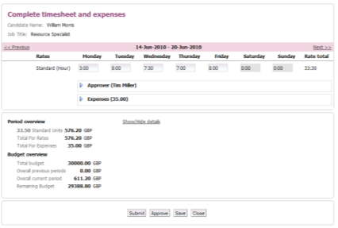
Timesheeting
A vital element of any employer/worker relationship in the contingent arena is the accurate and on-time confirmation of the time the individual has worked.
TalentLink’s Timesheeting platform, activated where required by job, ensures that information can be collected in real-time whenever the worker is instructed to add data.
Once hired workers are notified by email that timesheets have been activated for their position and how they can be accessed and completed.
Once completed timesheets go for manager approval before being accepted into payroll systems.
Timesheet data can be connected by API using our webservices, exporting or importing to TalentLink

Slide 12
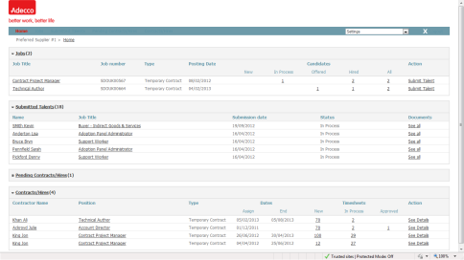
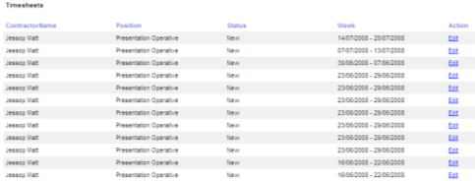
Recruitment Supplier Portal
Where contingent labour is submitted by an agency or other external labour supplier the brandable TalentLink Supplier Portal becomes the tool of choice.
As well as providing a valuable overview of submitted workers the tool also provides suppliers with the ability to complete Timesheets on behalf of the worker.

Slide 13
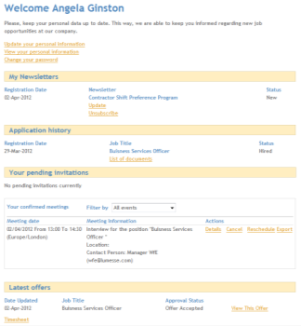
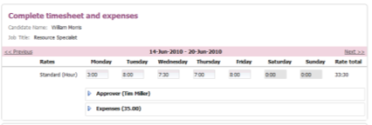
Online worker experience
TalentLink uses a candidate portal to guarantee an efficient collection of timesheet information from workers.
Candidate portal access can be from any page but typically customers deploy:
A specific webpage where workers can go, outside of the corporate firewall.
Access via the standard external careers website
Workers add their timesheet information on days that have been worked, even against multiple projects.
They can make additional comments, and allocate time to specific tasks as well as record expenses (scan invoices) to be re-paid.

Slide 14
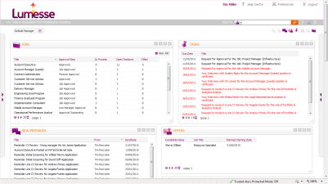
Line Managers’ experience
We understand that the financial risk of contingent labour is held in two places, the company contracting the worker, but specifically the cost centre of the line manager.
Associated line managers are alerted by email to approve online timesheets. TalentLink’s Manager Self Service portal steps in to ensure complete transparency of the timesheeting and worker processes.
Submitted timesheets are viewed by manager with the following features:
Submitted time (with alerts when exceeding standard working hours)
Related cost (based on time and contract terms), scanned invoices
Remaining budget, with alerts when exceeding approved budget

Slide 15
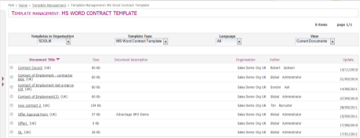
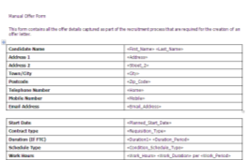
Producing contingent documentation
An essential efficiency in the turnaround of contract hires is the production of formal documentation.
TalentLink supports the volume and individual production of Letters and Contracts directly from the database into MS Word.
Customers can store an unlimited number of standard branded document templates, add to them with a comprehensive list of mail merge fields and then these two elements combine to produce personalized documentation for direct distribution to contractors.

Slide 16
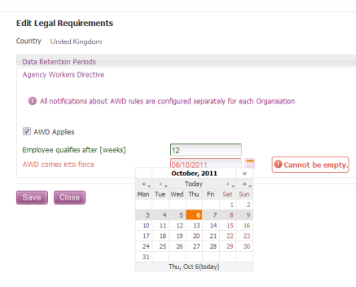
Managing Agency Workers Regulations Notification
TalentLink fully supports the notification processes involved with the UK Agency Worker Directive which came into force in 2011.
Functionality for defining reminders;
Define AWD to only apply in specific organisations;
Define reminder date and messaging;

Slide 17
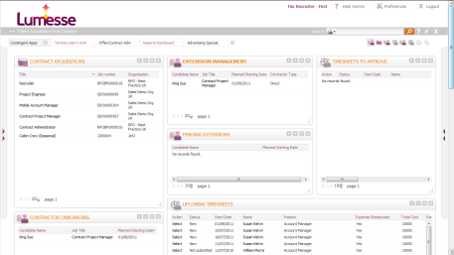
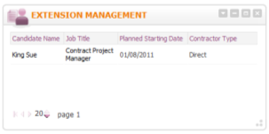
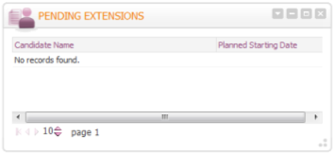
Managing extension to contracts
TalentLink supports the administrative burden of the extension management process.
Automated configurable apps push alerts to managers when contractors are about to reach their end dates offering an early warning to extend.

Slide 18
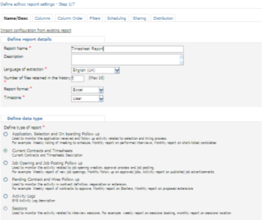
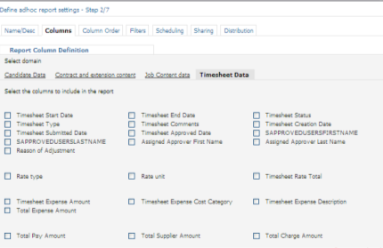
Reporting on contingent recruitment
There are two reporting segments for contingent recruitment in the TalentLink Ad Hoc Reporting Suite
Current Offers & Timesheets
Pending offer and hires follow up
Current Offers
This section covers all data in the Contract condition form plus all data in the timesheets.
Pending Offer
This section helps reporting on each condition form type, initial (first), current, last and extensions to conditions forms.

Slide 19
www.lumesse.com

