Slide 1
Talentlink Automation

Slide 2
Housekeeping
All participants on mute
Webinar will be recorded
Circulating slides, resources and asking for some feedback

Slide 3
What we will cover
What elements within Talentlink can be automated?
How can automation benefit your organisation?

Slide 4
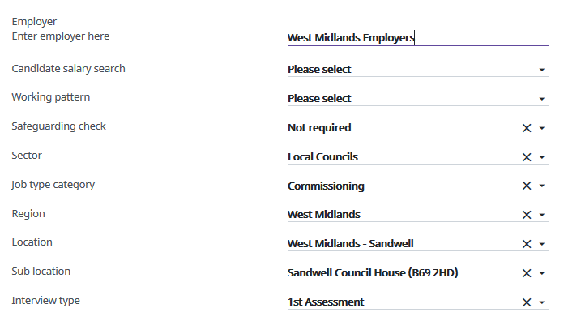
Talentlink Automation Job creation
Automate the view of your job fields
Automate the information entered when creating a job

Slide 5
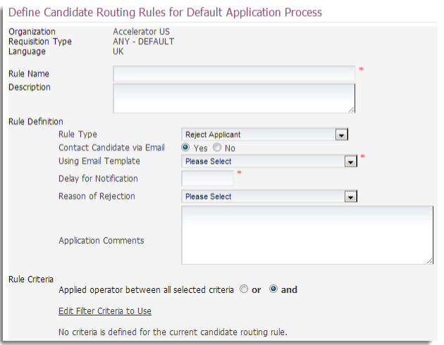
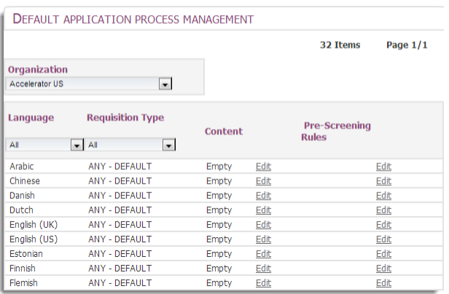
Talentlink Automation Application Process
Pre-Screening rules

Slide 6
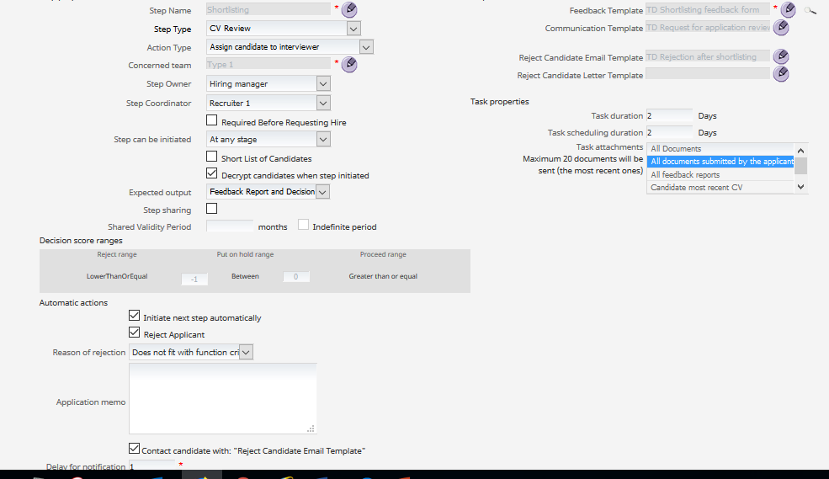
Talentlink Automation Selection process

Slide 7
Talentlink Automation Selection process

Slide 8
Talentlink Automation Contracts
Why automate your contracts?
Reduce duplication of data entry
Obtain it directly from the source
Improve accuracy and consistency
Speed of production
Areas of the system you can use
Job Requisition
Conditions Form
Standard Lumesse Fields from the Personal Information Form (PIF)
User Data
Team Members Information

Slide 9
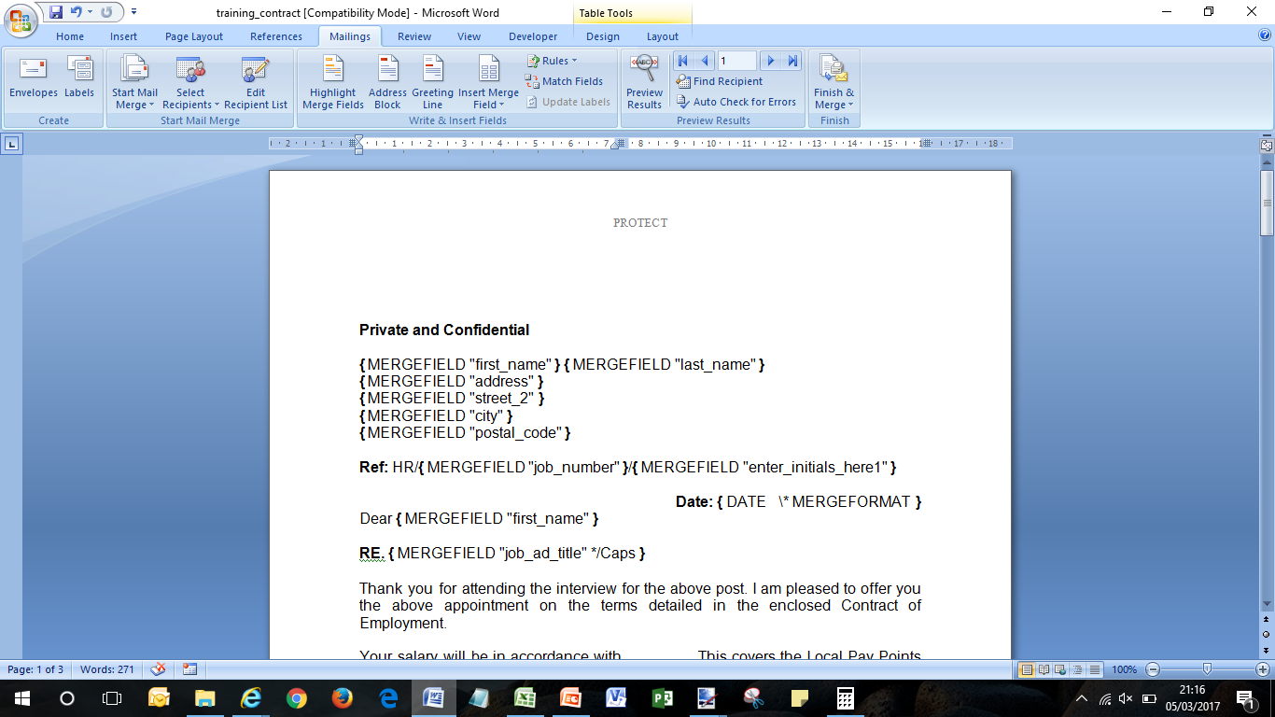
Talentlink Automation Contracts

Slide 10
Talentlink Automation Contracts – The benefits
Multiple contract versions reduced to a single template
Reduction in processing time of 15-30 mins per contract
Decrease in manual input.
Elimination of stationary, printing and postage costs.
Reduction in the time to offer.
Improved auditing.
More efficient process for the new employee, a great way to start the on-boarding process through a fast, efficient, technology driven offer process.

Slide 11
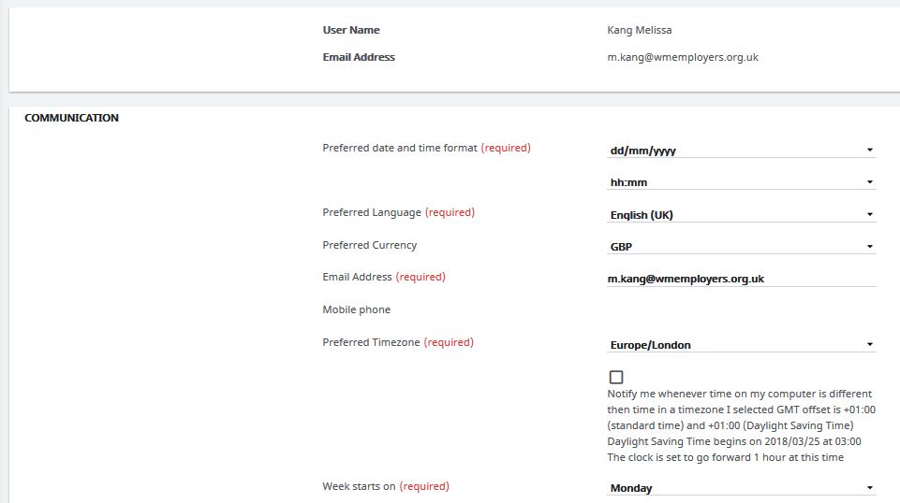
Talentlink Automation User settings/notifications

Slide 12
Talentlink Automation User settings/notifications

Slide 13
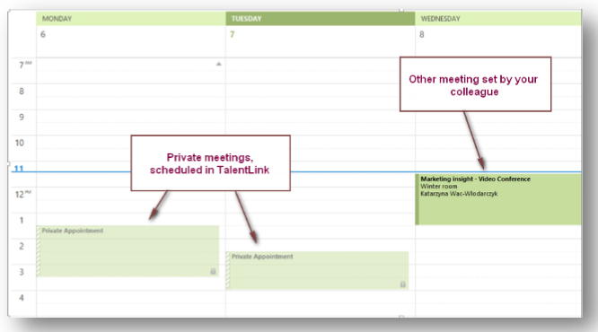
What is coming.... Outlook Integration

